Slide 1
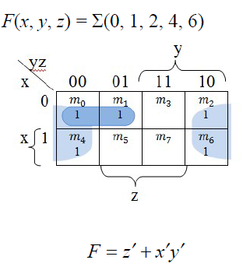

Slide 2
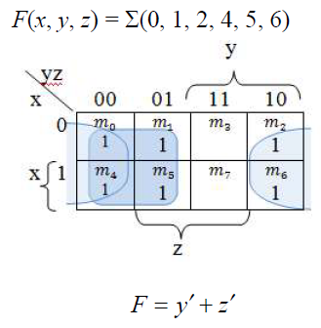

Slide 3
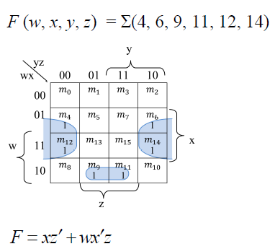

Slide 4
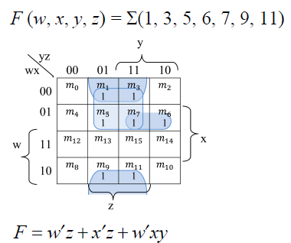

Slide 5
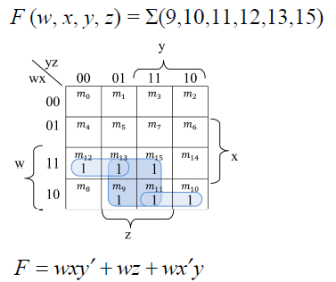

Slide 6
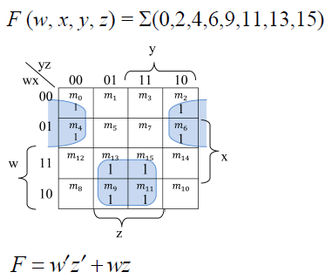

Slide 7
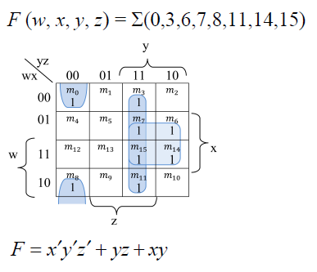

Slide 8
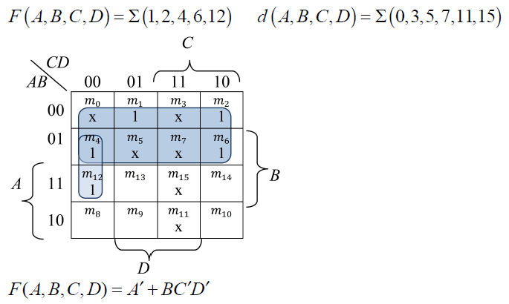

Slide 9
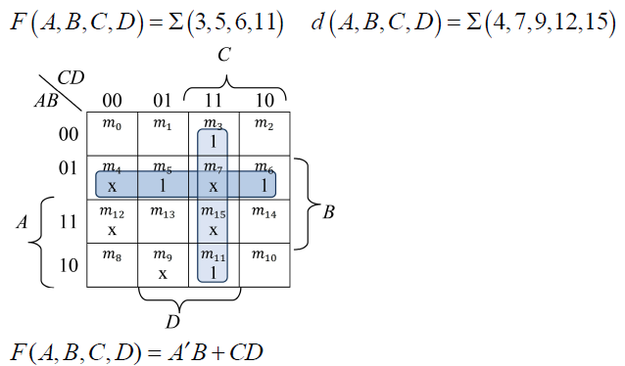

Slide 10
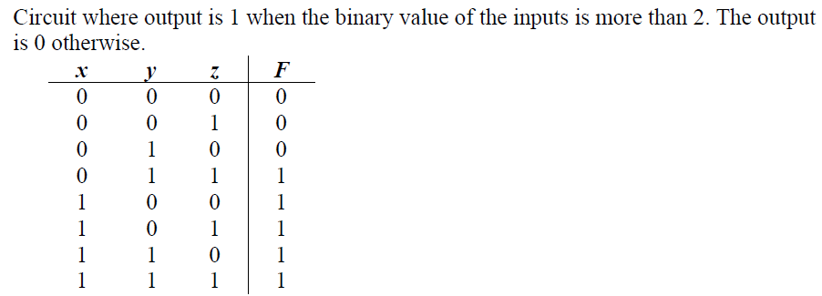
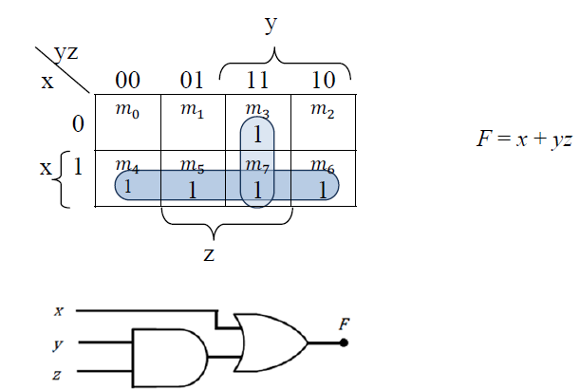

Slide 11
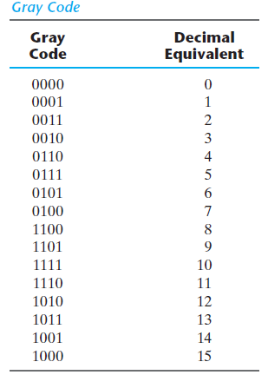
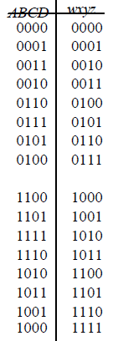

Slide 12
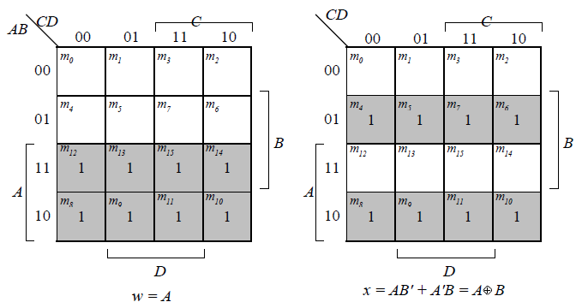

Slide 13
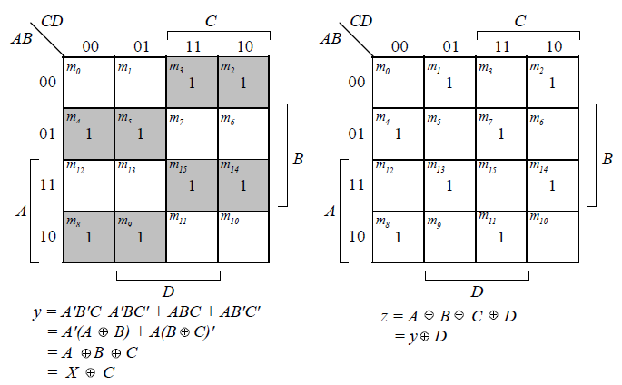
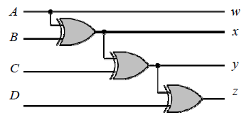

Slide 14
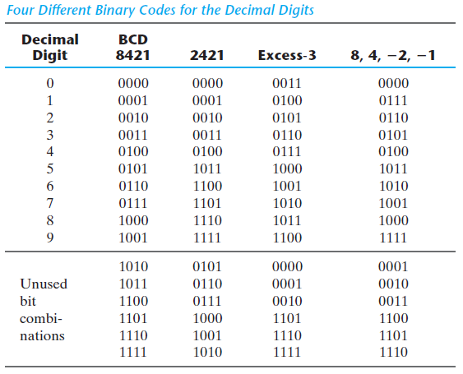
Design a code converter that converts a decimal digit from BCD8421 code to Gray code.

Slide 15
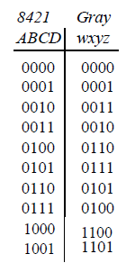
Design a code converter that converts a decimal digit from BCD8421 code to Gray code.

Slide 16
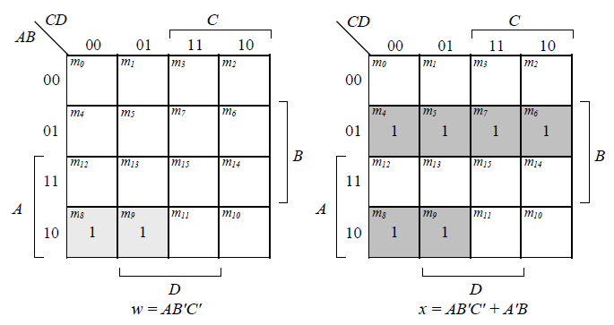
Design a code converter that converts a decimal digit from BCD8421 code to Gray code.

Slide 17
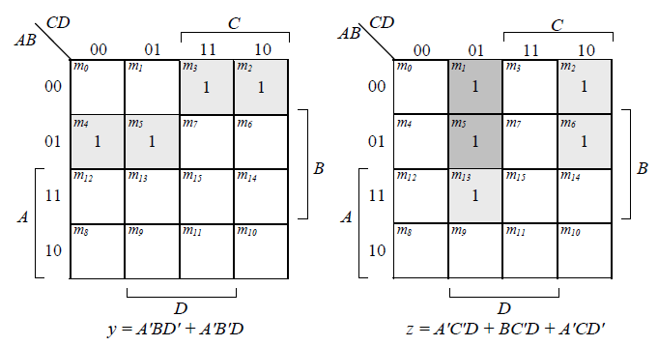
Design a code converter that converts a decimal digit from BCD8421 code to Gray code.

Slide 18
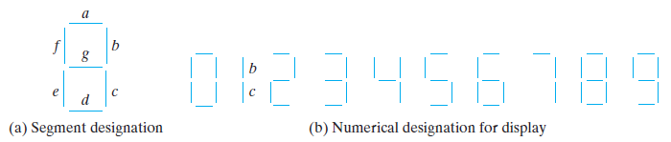
An ABCD-to-seven-segment decoder is a combinational circuit that converts a decimal digit in BCD to an appropriate code for the selection of segments in an indicator used to display the decimal digit in a familiar form.
The seven outputs of the decoder (a, b, c, d, e, f, g) select the corresponding segments in the display, as shown in (a) .
The numeric display chosen to represent the decimal digit is shown in (b). Using a truth table and Karnaugh maps, design the BCD-to-seven-segment decoder using a minimum number of gates. The six invalid combinations should result in a blank display.

Slide 19
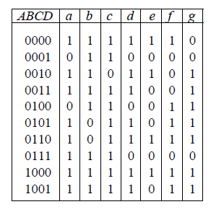
Using a truth table and Karnaugh maps, design the BCD-to-seven-segment decoder:

Slide 20
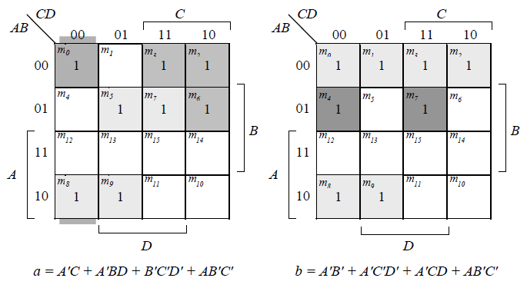
Design the BCD-to-seven-segment decoder:

Slide 21
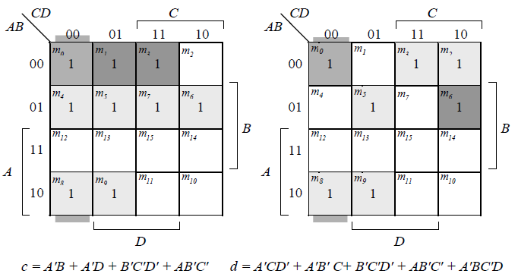
Design the BCD-to-seven-segment decoder:

Slide 22
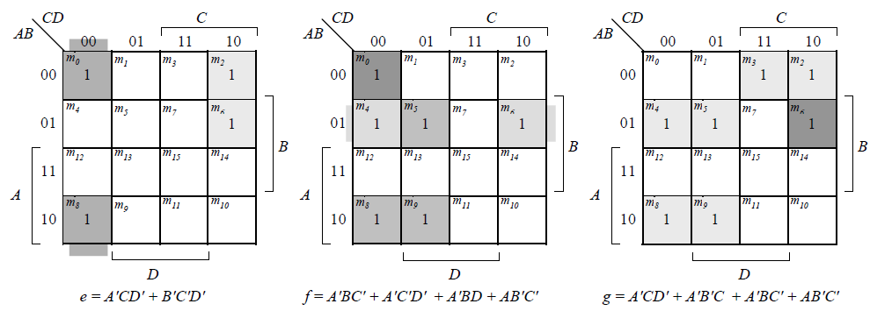
Design the BCD-to-seven-segment decoder:

Slide 23
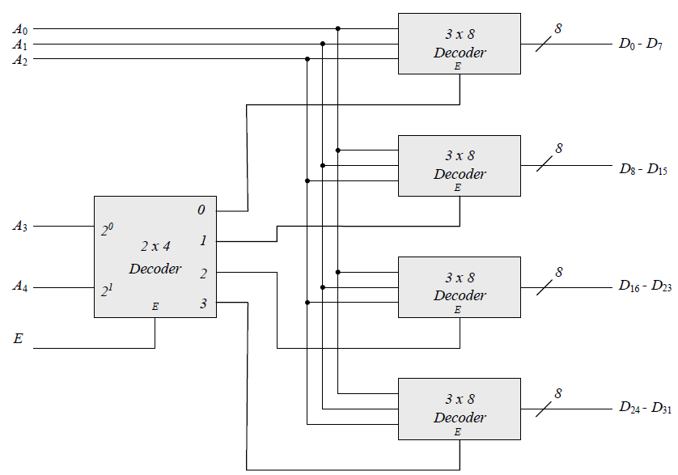

Slide 24
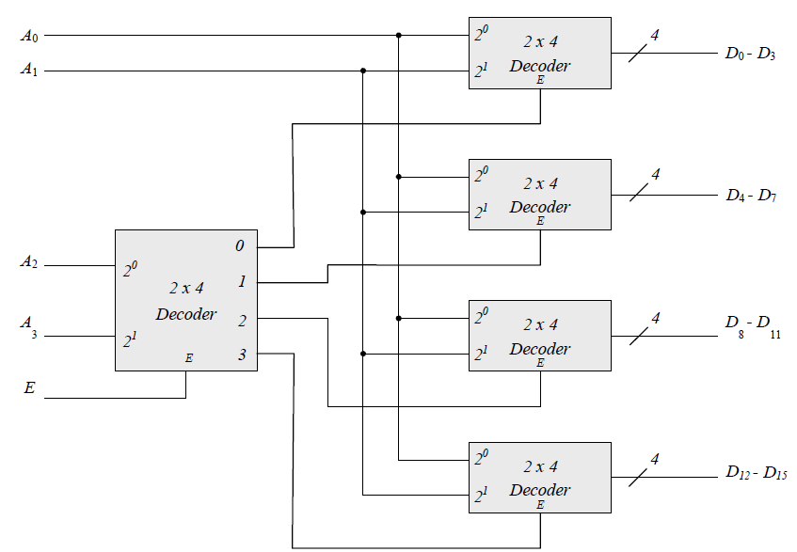

Slide 25
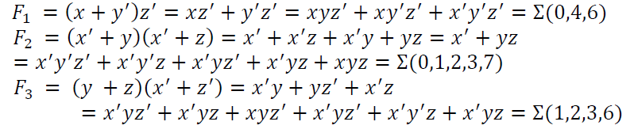
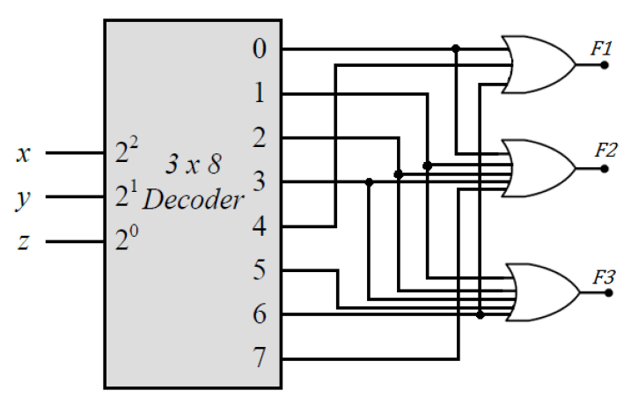

Slide 26
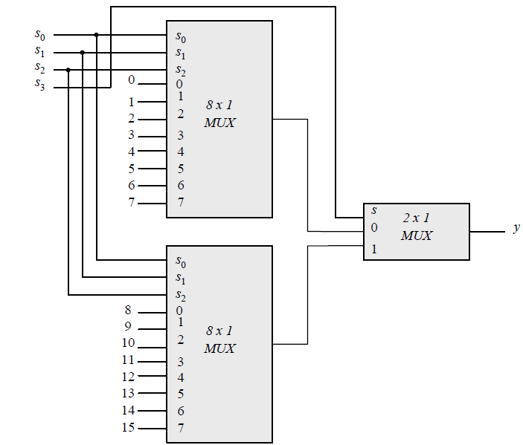

Slide 27
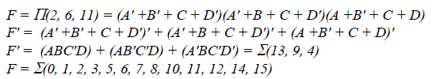
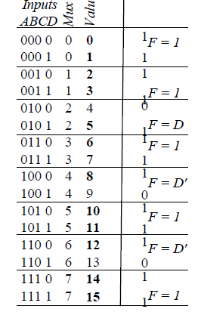
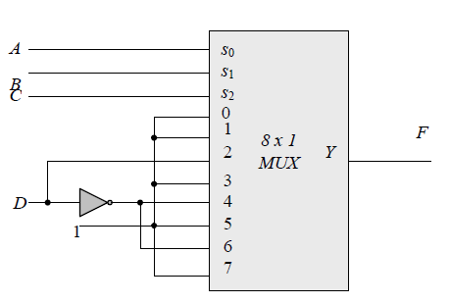
De Morgan’s Law
De Morgan’s Law

Slide 28
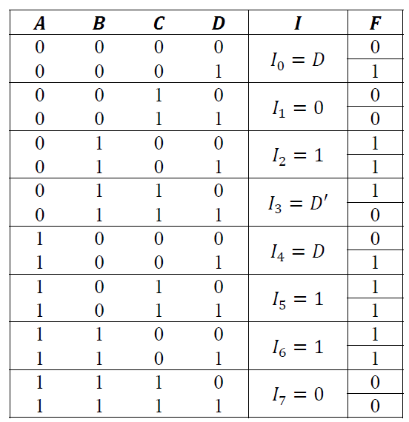
$$I_{1}=I_{7}=0;I_{0}=I_{4}=D;I_{2}=I_{5}=I_{6}=1;I_{3}=D′$$

Slide 29
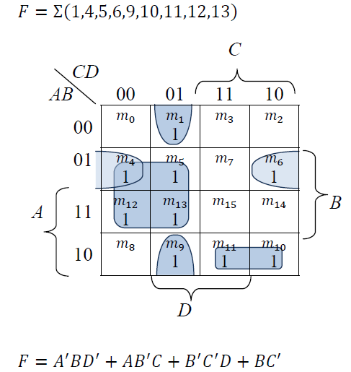

Slide 30
